Slide 1

Student Details
Name: Jampula Sai Rahul Chowdhary
Email: sairahulchowdhary.j@gmail.com
AICTE ID: STU6461e4647c85f1684137060
Organisation: DGT
College Name: Manipal Institite of Technology
Domain: Data Analytics
Internship Name: IBM SkillBuild
Duration: 12th June -24th July
Foundation: Edunet

Slide 2

Data Analysis On Super Store Data

Slide 3

PROJECT TOPIC
Case study: Analysis of the Superstore
The project will focus on analyzing the sales data of a superstore to gain insights into customer behavior, popular products, and seasonal trends.

Slide 4
AGENDA
The presentation will cover the following agenda:
1. Introduction to the Superstore dataset
2. Data preparation and cleaning
3. Exploratory data analysis
4. Statistical analysis
5. Data visualization
6. Conclusion and key findings

Slide 5

WHO ARE THE END USERS?
The analytics from this study can be used by:
Retail store managers for optimizing inventory and store layout.
Sales teams for identifying high-potential customers and cross-selling opportunities.
Marketing teams for targeted campaigns and personalized promotions.
Business analysts for strategic decision-making and market trend analysis.

Slide 6

SOLUTION AND PRESENTATION
The project will employ various data analytics techniques, including data cleaning, data visualization, and predictive modeling.
The presentation will showcase the step-by-step process of analyzing the dataset and presenting the findings effectively.

Slide 7
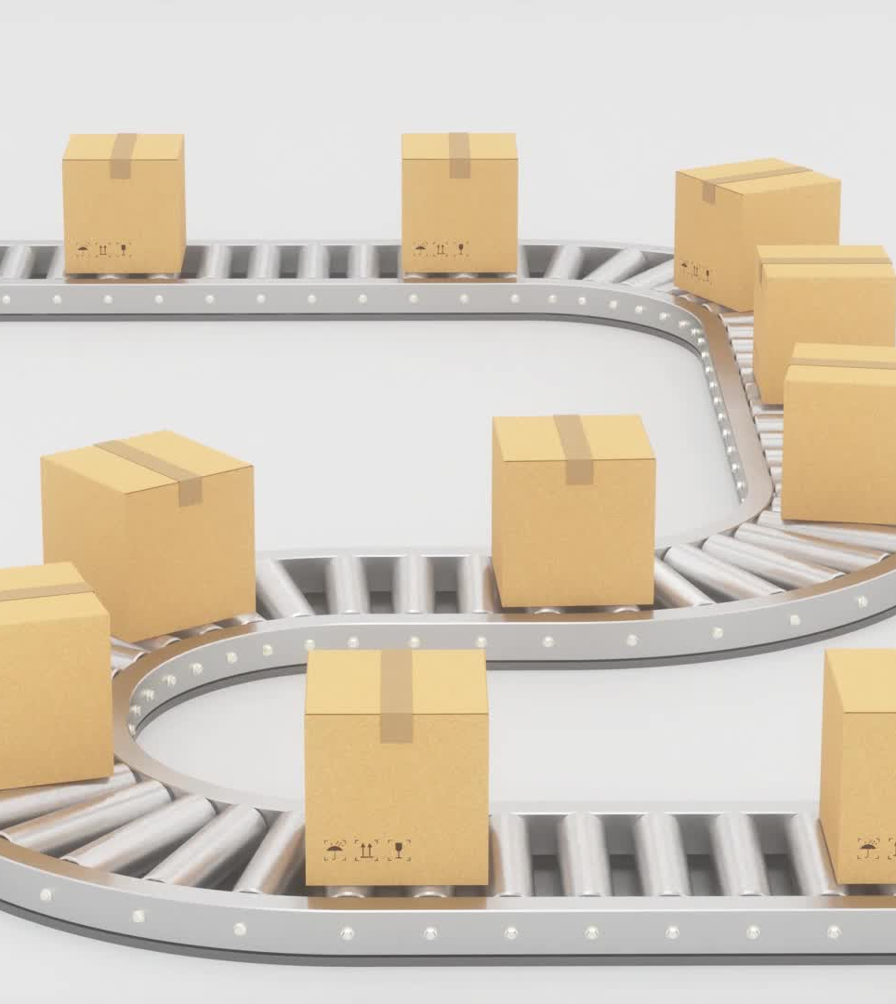
Introduction to the Superstore dataset
The Superstore Dataset (Sample_Superstore.csv) comprises sales data from an online retail store, featuring 85 product categories across Furniture, Office Supplies, Technology, Accessories, and Other products. Each entry includes Order ID, Customer ID, Product details, Sales, Quantity, and other information like Ship mode, Order date, and Customer segment.
This dataset offers valuable opportunities for analyzing sales performance, identifying customer trends, evaluating shipping methods, optimizing pricing and discounts, and informing inventory management. Through this presentation, we will delve into these insights and unlock the dataset's potential for data-driven decision-making.

Slide 8

Data preparation and cleaning
Data preparation and cleaning are crucial steps in the data analysis process. In data preparation, we gather, select, and organize the relevant data for analysis. This involves handling missing values, removing duplicates, and encoding categorical variables for effective use. By ensuring data quality and consistency, we lay the foundation for meaningful insights.
Data cleaning involves identifying and rectifying errors or inconsistencies in the dataset. This process includes removing outliers, correcting data format issues, and dealing with noisy or irrelevant data. Through these essential steps, we create a clean and reliable dataset, setting the stage for accurate and reliable analysis and modeling.

Slide 9
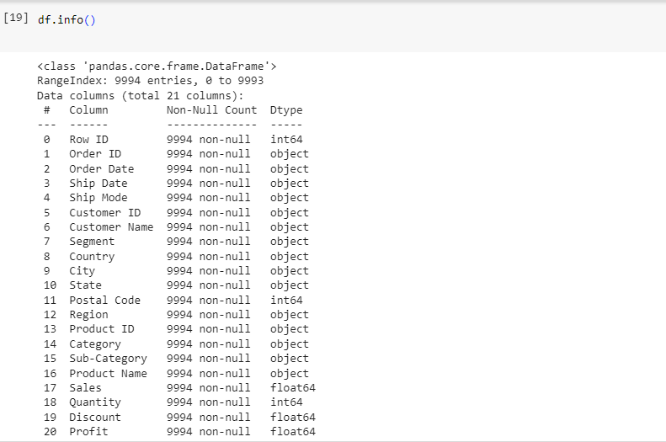
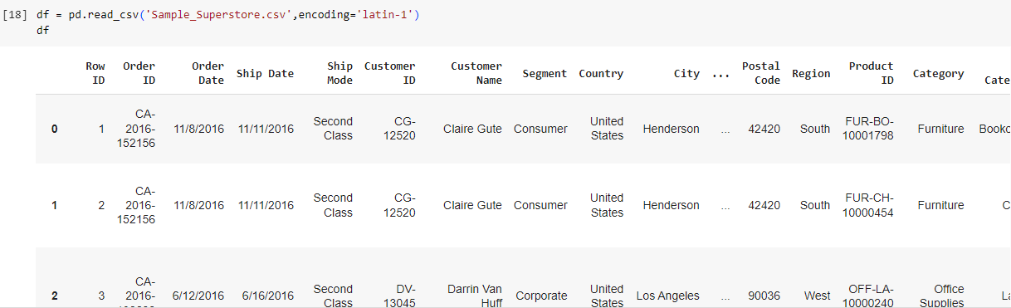
Data Preparation

Slide 10
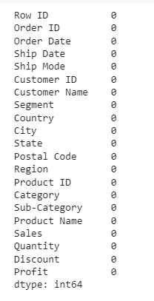
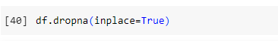
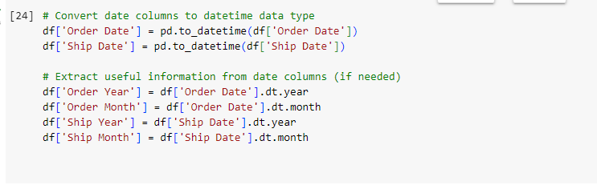
Preprocessing & Cleaning
Handling missing data

Slide 11

MODELLING
The modeling process involves:
Exploratory Data Analysis (EDA) is the process of exploring and understanding data through visualization and statistical analysis. It is an important step in the modelling process, as it helps to identify patterns and relationships in the data that can be used to build better models.
Data Visualization is the use of graphical representations of data to communicate insights. It can be a powerful tool for understanding complex data and communicating findings to others

Slide 12
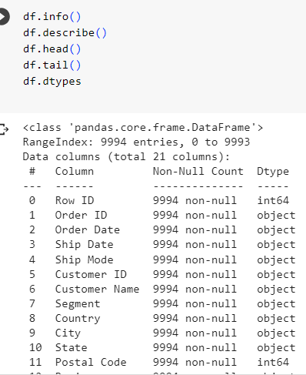
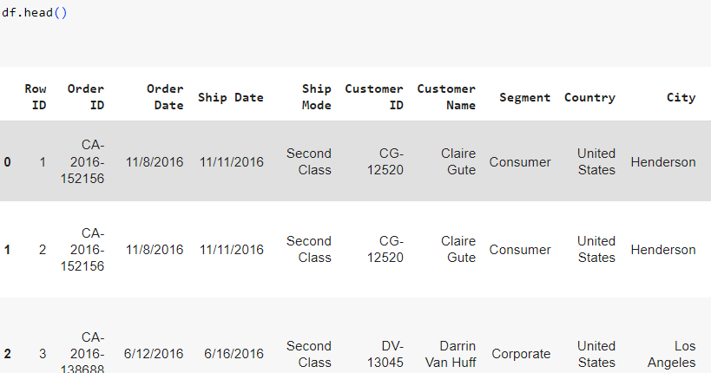
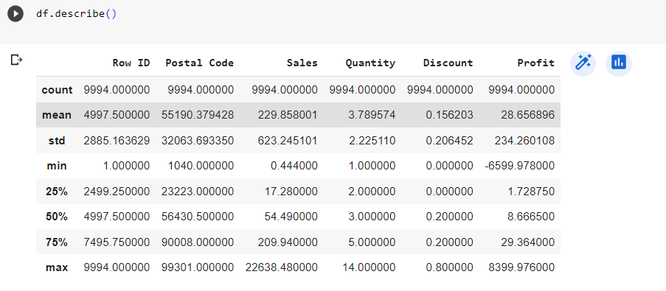
EDA :

Slide 13
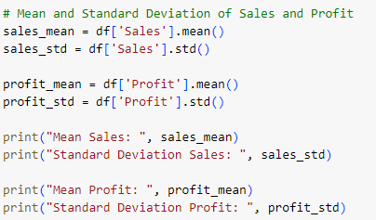
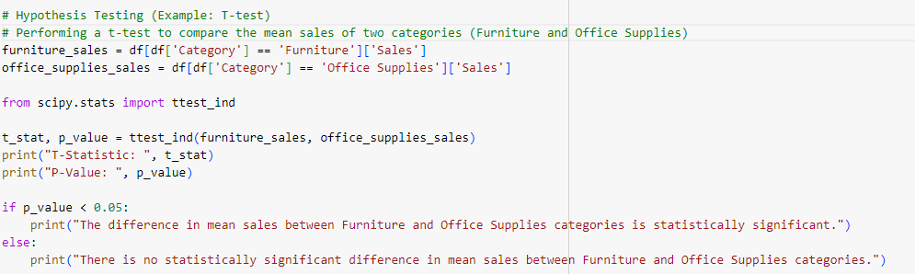
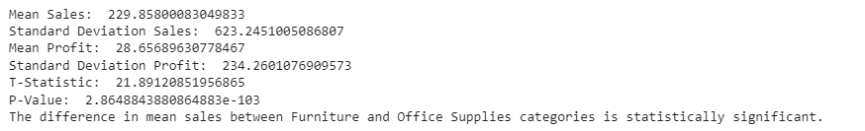
Statistical analysis :

Slide 14
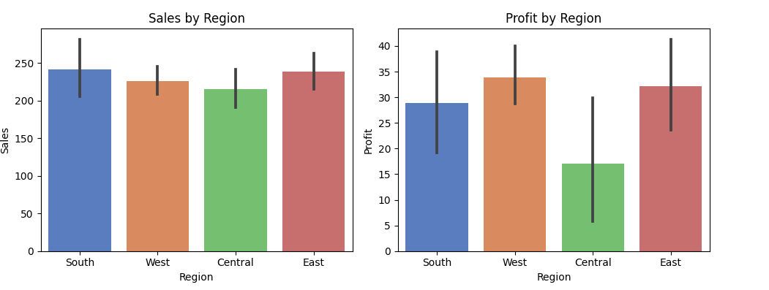
Data Visualization :

Slide 15
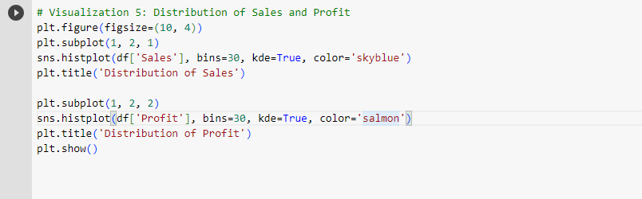
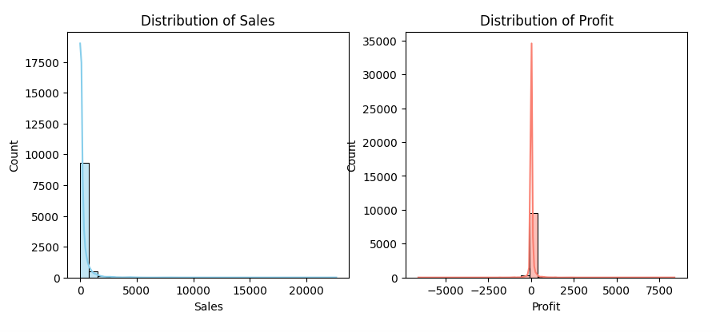
Distribution of Sales and Profit

Slide 16

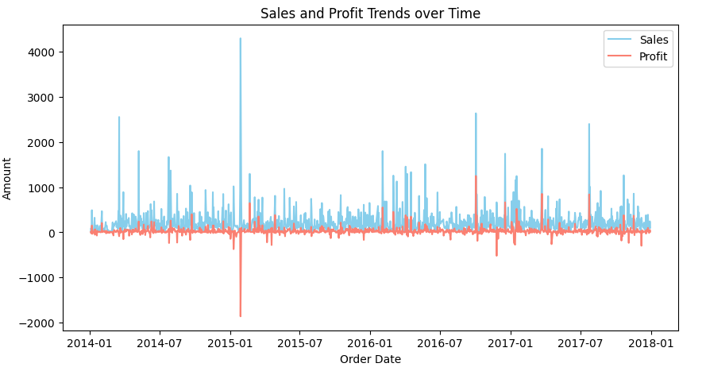
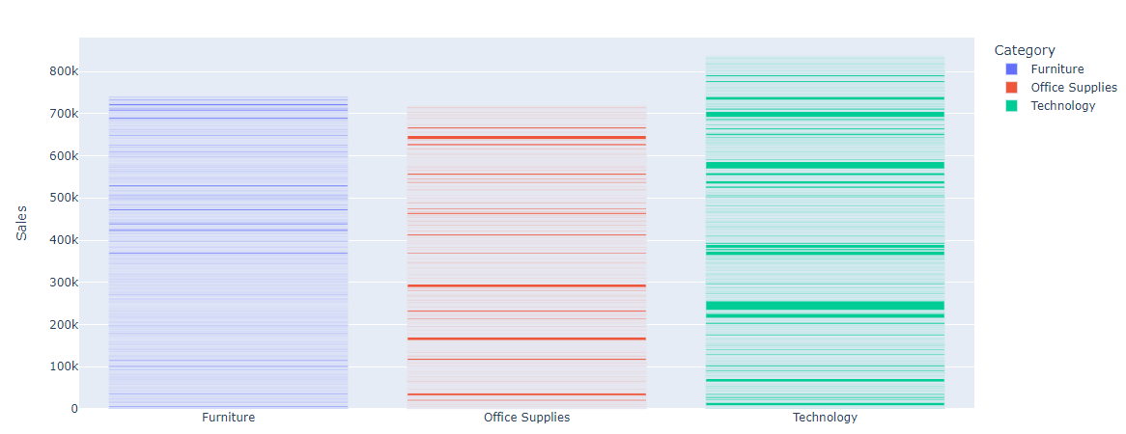
Sales and Profit trends over time
Sales by Category - Plot Bar Chart

Slide 17
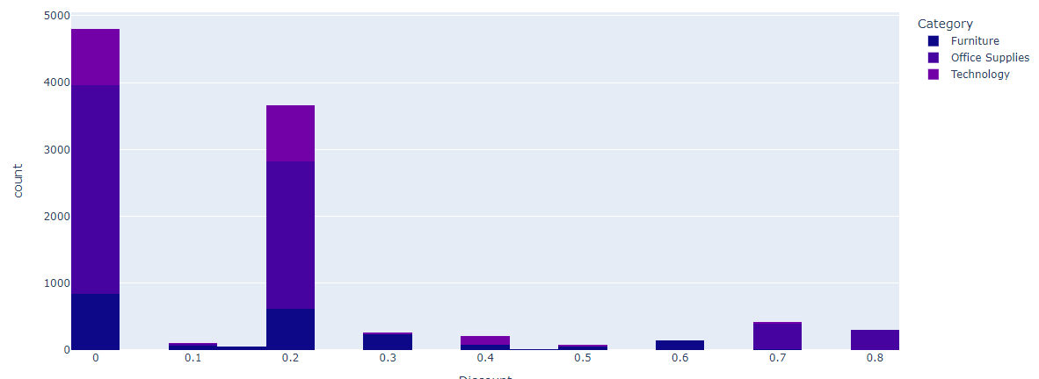
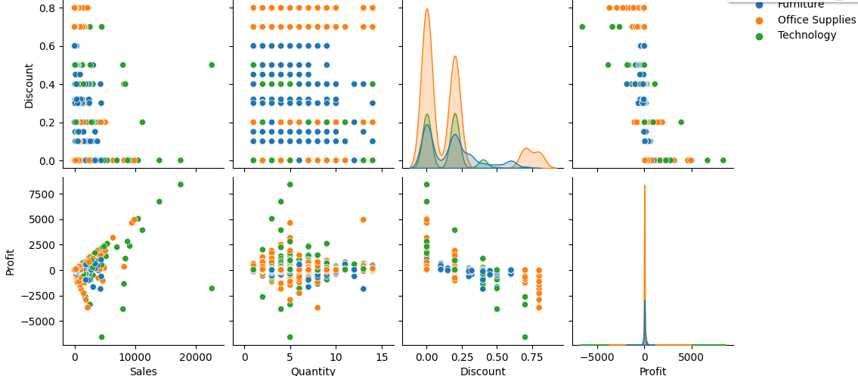
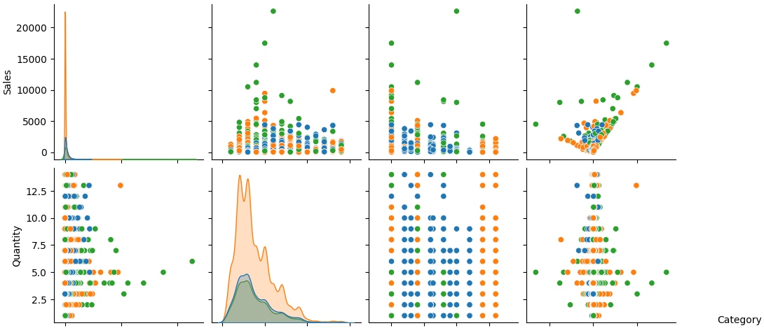
Distribution of Discount - Plot Histogram
Pair plot of sales , profit, quantity, discount

Slide 18
PROJECT OVERVIEW
Advantages of the analysis:
Improved inventory management: The analysis will help identify slow-moving items and optimize stock levels.
Enhanced decision-making: Data-driven insights will aid in making informed business decisions.
Increased customer satisfaction: Understanding customer preferences will lead to better service.
Limitations:
Lack of external data sources: The analysis may not consider external factors that could impact sales.
Limited historical data: The dataset may not cover a long period, limiting long-term trend analysis.
Data privacy concerns: Ensuring data security and privacy will be crucial.
Scope :
•Analyze customer purchase data to gain customer insights
Purpose
•Identify high value customer segments
•Understand product affinity and trends
•Determine customer lifetime value

Slide 19

WOW IN ANALYTICS
Benefits of data analytics:
Flexibility and adaptability: The ability to explore and analyze data from various angles.
Improved decision-making: Data-driven insights lead to better strategic choices.
Enhanced data visualization: Visual representation for better understanding and communication.
Predictive modeling capabilities: Forecasting future trends and outcomes.

Slide 20
RESULTS
The analysis generated insightful reports on sales trends, customer segments, and product performance.
Cloud-based analytics platform allowed for seamless collaboration and access to real-time data.
The project source code is available on GitHub:Rahulchowdhary592/IBM_Internship (github.com)

Slide 21
LINKS
For more information and resources, please visit the following links:
GitHub Repository: Rahulchowdhary592/IBM_Internship (github.com)
Dataset Source: https://data.world/stanke/sample-superstore-2018
Related Articles: https://www.analyticsvidhya.com/blog/2022/03/eda-on-superstore-dataset-using-python/

Slide 22

THANK YOU

